Slide 1

THE IMPERIAL MANAGEMENT
HOTEL APPLICATION
Krishal, Sanjit and Cara

Slide 2
SCOPE
To create an Android Application for Housekeepers, Management and Front Desk staff within the Accommodation Industry to use in order to lessen time used to report a room status.
AIM
To create order and reduce loss of time for Housekeepers and Management within the Accommodation Industry.
OBJECTIVES
1] Research current methods used within the Accommodation Industry in respect to room maintenance.
2] Design, create and test an Android Application.
4] Design and create a database.

Slide 3
MOVs
1] OPERATIONAL IMPACT –
Our applications will make communication faster for the Housekeepers and Front Desk staff as it will allow communication in both directions to be done in real-time, without them having to travel to find the person(s) they wish to report to.
2] CUSTOMER
Our aim is to get our application to at lest 20 to 40 accommodation providers in Manukau area as there are about 70-75 motels in this region alone hence why we are looking to approach local providers and then reach out in to the larger market as this will provide with hands on testing in the real market and allow use to amend any bugs in the system. We anticipate to getting 150 members within the first year of launch in to the market.
This will be done through advertising through emails to companies and also through arranged meetings with either the owner and or the manager.

Slide 4
3] FINANCE
From the research we have conducted we found that there are many companies providing same to similar software's to businesses however they are generally to large companies such as hotels and hence charging more for the systems, its subscription based and they charge about $200NZD per month to $350NZD per month . This is why most of the small accommodation are unable to have this system, agree that those systems have more functionalities but its not needed in motel setting, hence we have come up with a low figure of $99NZD per month per site, as our application would be simple and just around housekeeping management only if we can then in the near future we can expand this and add more functionalities if we can ensure it doesn’t affect pricing too much.

Slide 5
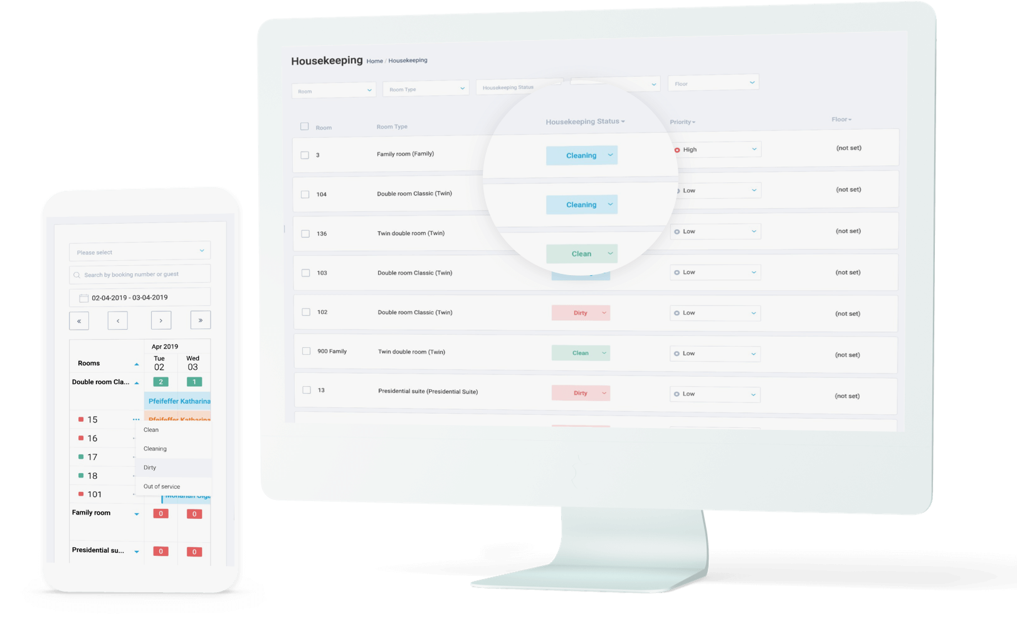
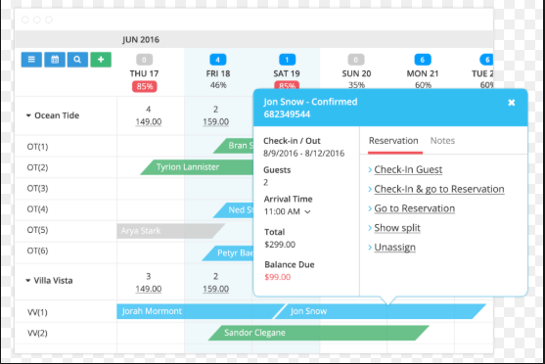
EXISTING SYSTEMS
HotelFriend
Hotel friend provides multiple management application such as Hotel Management System, Central Reservation System, Property Management System, and Software for Small Hotels
Deal, Package Composer, Mobile concierge app
Hotel Guestbook Mobile App, Room Service Mobile App and also Hotel Website Development applications.
CloudBed Reservation
This app is multi task that can connect to hundred of channels from your property such as booking.com and Orbitz and it allow guests to make direct booking from their desktop, phone and through Facebook so, this app so handy and gives good impact for small business e.g. - Hotel and Motel.

Slide 6
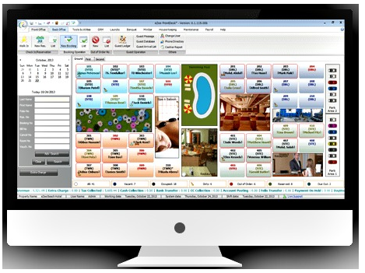
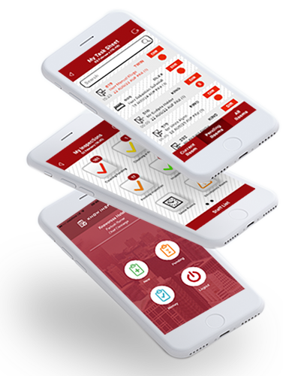
eZee Front Desk
App is mainly used by small lodge, hotel and motel and company claim that app is using in 140 countries all around the world and more than 1 million transaction in a day and across hotel management property resulting in 90,000 room manged and 70,500 users by eZee Front Desk app.
Receive application report on phone and tablets.
Event Management.
Self-service check in Kiosk.
KnowCross
Know housekeeping does also provide easy to use application on android and IOS devices hence making it much easier to the user built into the application has options to select Multilanguage interface to reduce language barrier. This application also can contacts to your PMS therefore the front desk will be aware of rooms which are dirty, clean, inspected. Know Housekeeping applications automatically allocated rooms and will prioritization rooms depending on guest requests of early check-in. Know Housekeeping will also look at your linen count and will report to front desk to order more linen and will calculate depending on how many check out of how much linen is required.

Slide 7
METHODOLOGY

Slide 8
RISKS AND MITIGATION

Slide 9
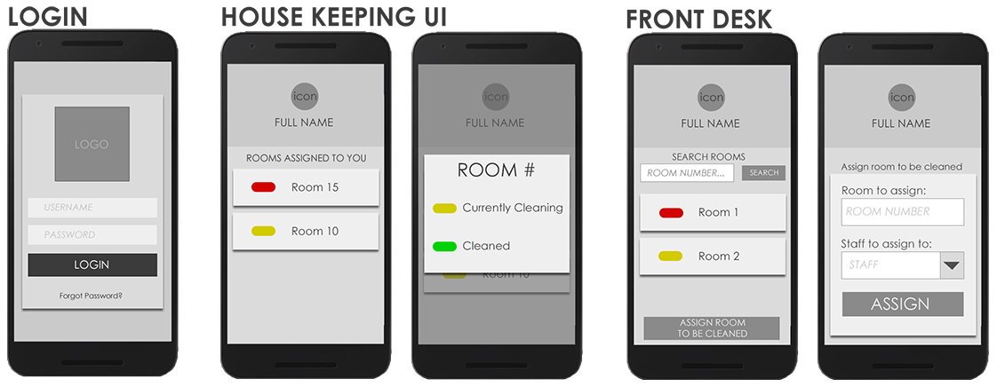
DESIGN
UI

Slide 10
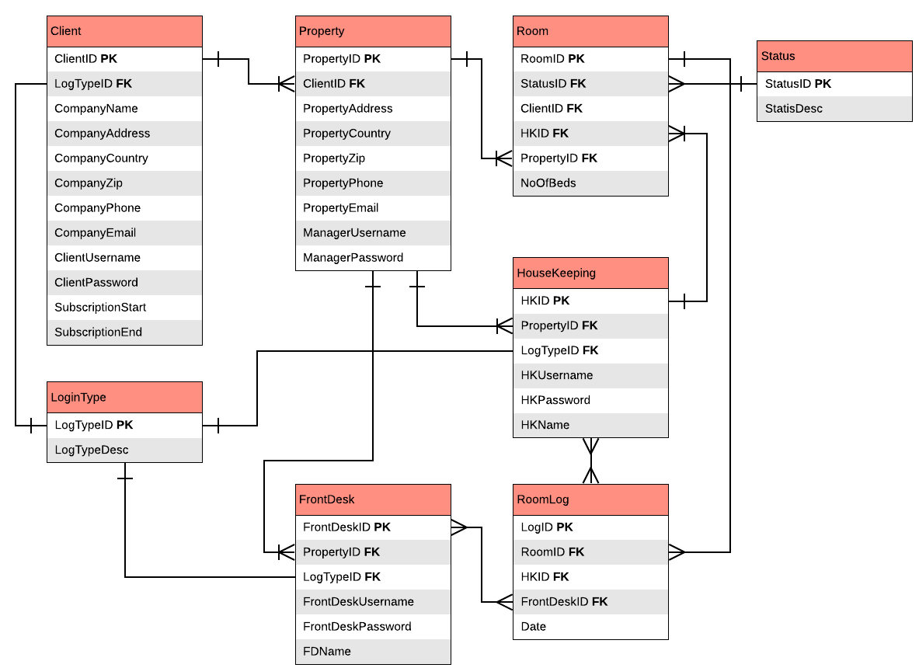
ERD

Slide 11
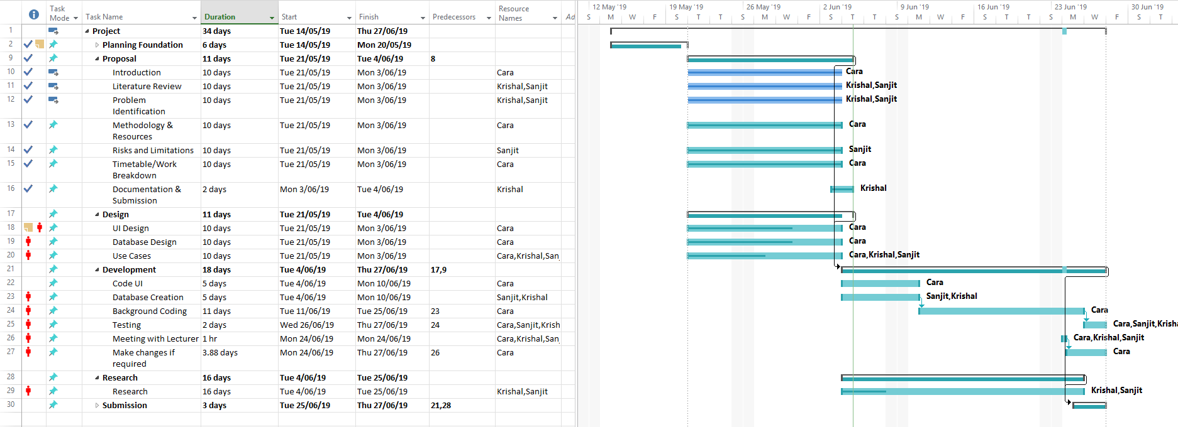
GANTT CHART

Slide 12

THANK YOU

Slide 13
REFERENCES

